Slide 1
System Intelligence Laboratory

Slide 2
Snakes and Sirens: Can Sines Help Deep Learning?
Federico Berto

Slide 3
Contents
Neural Networks Fail to Learn Periodic Functions and How to Fix It (NeurIPS 2020)
Implicit Neural Representations with Periodic Activation Functions (NeurIPS 2020, Oral)
Extra material (referenced during presentation)

Slide 4
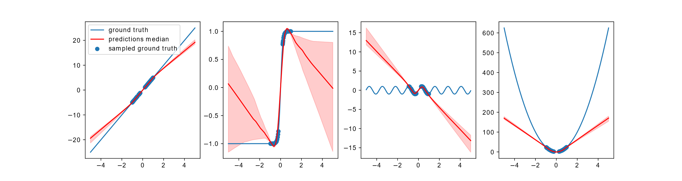
Motivation
Activation functions are rarely taken into account in model design
Certain functions e.g. ReLU perform well while interpolating
How about extrapolating? Can we learn well outside of the boundaries?
ReLU interpolation and extrapolation with different functions

Slide 5
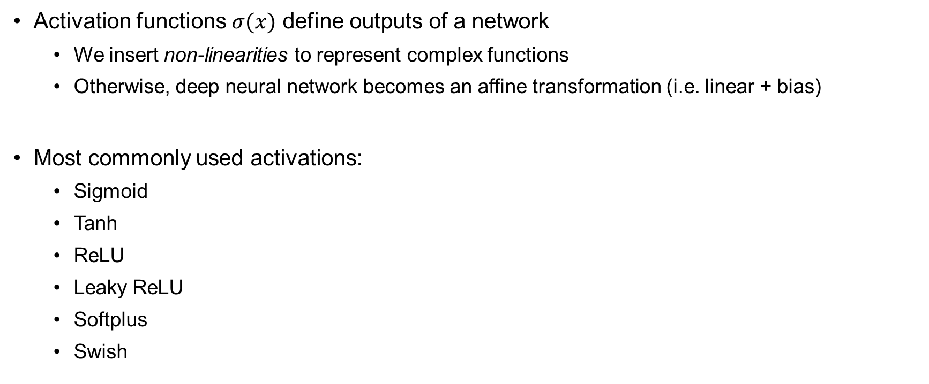
Activation Fuctions
Activation functions $σ(x)$ define outputs of a network
We insert non-linearities to represent complex functions
Otherwise, deep neural network becomes an affine transformation (i.e. linear + bias)
Most commonly used activations:
Sigmoid
Tanh
ReLU
Leaky ReLU
Softplus
Swish

Slide 6
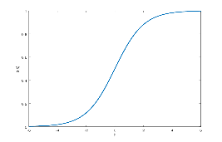
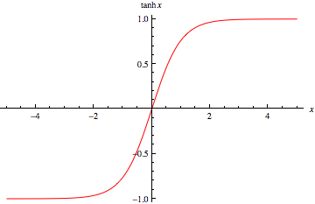
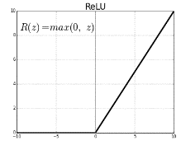
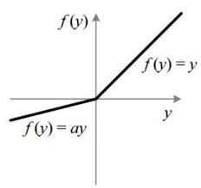
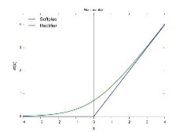
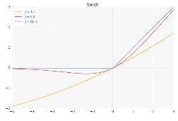
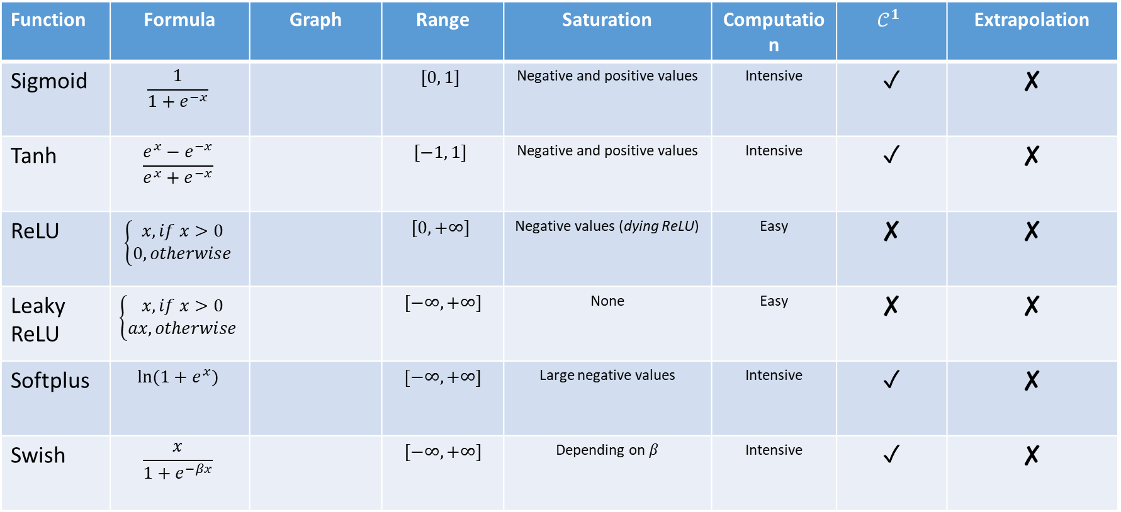
Overview of Commonly Used Activation Fuctions
Function | Formula | Graph | Range | Saturation | Computation | $$𝒞^{1}$$ | Extrapolation
Sigmoid | $$\frac{1}{1+e^{−x}}$$ |  | $$[0, 1]$$ | Negative and positive values | Intensive | ✓ | ✘
Tanh | $$\frac{e^{x}−e^{−x}}{e^{x}+e^{−x}}$$ |  | $$[−1, 1]$$ | Negative and positive values | Intensive | ✓ | ✘
ReLU | $$\left\{\begin{aligned}x, if x>0 \\ 0, otherwise\end{aligned}\right.$$ |  | $$[0, +∞]$$ | Negative values (dying ReLU) | Easy | ✘ | ✘
Leaky ReLU | $$\left\{\begin{aligned}x, if x>0 \\ ax, otherwise\end{aligned}\right.$$ |  | $$[−∞, +∞]$$ | None | Easy | ✘ | ✘
Softplus | $$ln⁡(1+e^{x})$$ |  | $$\left[−∞, +∞\right]$$ | Large negative values | Intensive | ✓ | ✘
Swish | $$\frac{x}{1+e^{−βx}}$$ |  | $$[−∞, +∞]$$ | Depending on $β$ | Intensive | ✓ | ✘

Slide 7
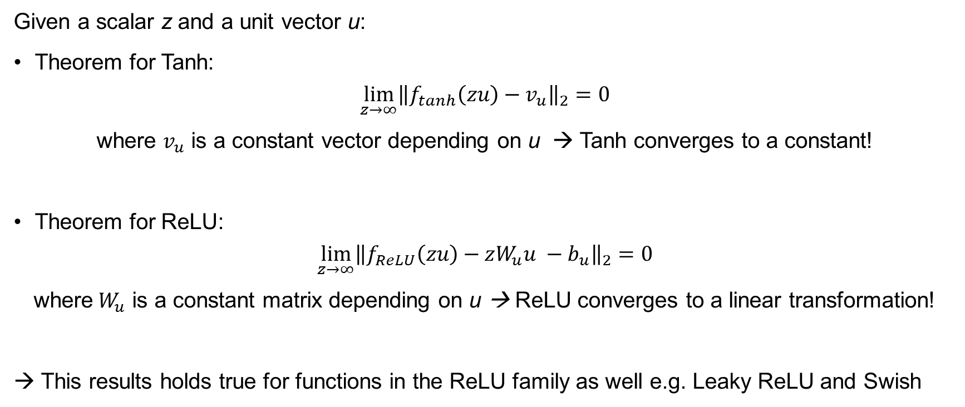
Why can’t these functions extrapolate?
Given a scalar z and a unit vector u:
Theorem for Tanh:
$$\lim_{z→∞}{{\left\|f_{tanh}\left(zu\right)−v_{u}\right\|}_{2}=0}$$
where $v_{u}$ is a constant vector depending on u → Tanh converges to a constant!
Theorem for ReLU:
$$\lim_{z→∞}{\left\|f_{ReLU}\left(zu\right)−zW_{u}u −b_{u}\right\|}_{2}=0$$
where${ W}_{u}$ is a constant matrix depending on u → ReLU converges to a linear transformation!
→ This results holds true for functions in the ReLU family as well e.g. Leaky ReLU and Swish

Slide 8
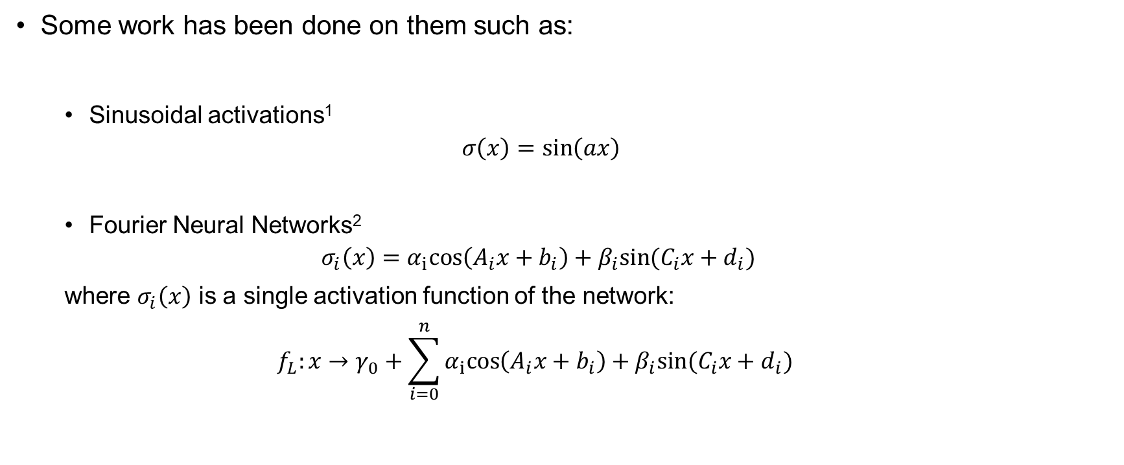
Sinusoidal Activation Functions
Some work has been done on them such as:
Sinusoidal activations¹
$$σ\left(x\right)=\sin\left(ax\right)$$
Fourier Neural Networks²
$$σ_{i}\left(x\right)=α_{i}cos\left(A_{i}x+b_{i}\right)+β_{i}sin⁡(C_{i}x+d_{i})$$
where $σ_{i}\left(x\right)$ is a single activation function of the network:
$$f_{L}:x→γ_{0}+\sum_{i=0}^{n}{α_{i}cos\left(A_{i}x+b_{i}\right)+β_{i}sin⁡(C_{i}x+d_{i}) }$$

Slide 9
Sinusoidal Activation Functions: Pros and Cons
Pros
Universal extrapolation properties
Can learn some a priori known periodic signals better than alternatives
Cons
Difficult to train (degeneracy in local minima)
Computationally Expensive
Cannot compete against ReLU on standard tasks
→ In these formulations, sinusoidal activations seem to be not competitive against alternatives!

Slide 10
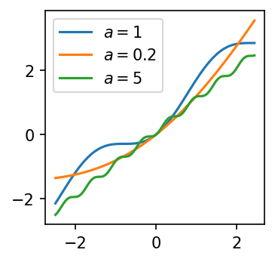
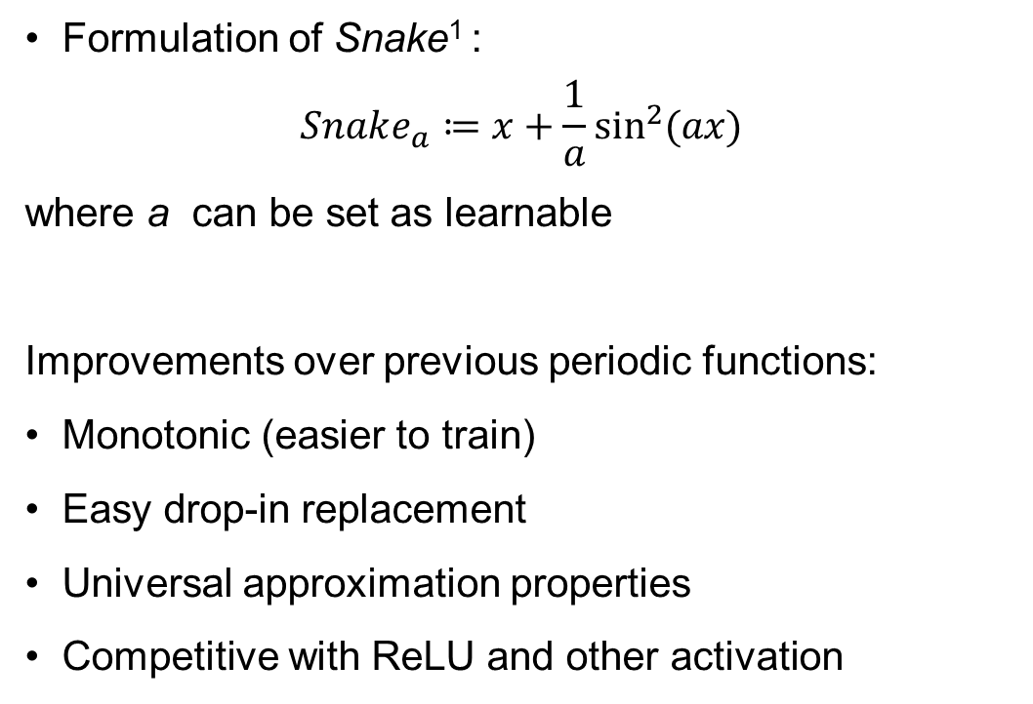
Snake
Formulation of Snake¹ :
$$Snake_{a}≔x+\frac{1}{a}\sin^{2}{(ax)}$$
where a can be set as learnable
Improvements over previous periodic functions:
Monotonic (easier to train)
Easy drop-in replacement
Universal approximation properties
Competitive with ReLU and other activation
Snake with different a: this parameter regulates the frequency

Slide 11
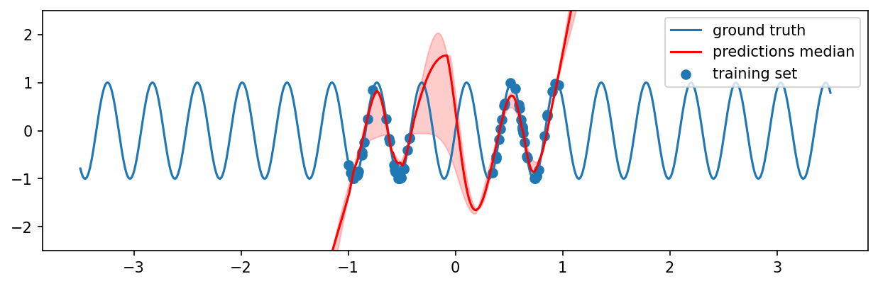
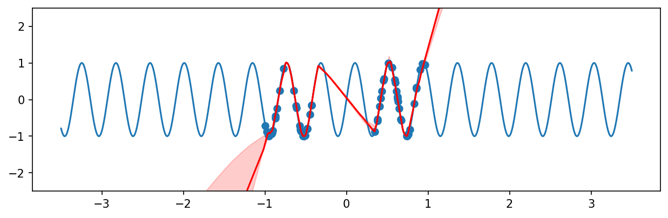
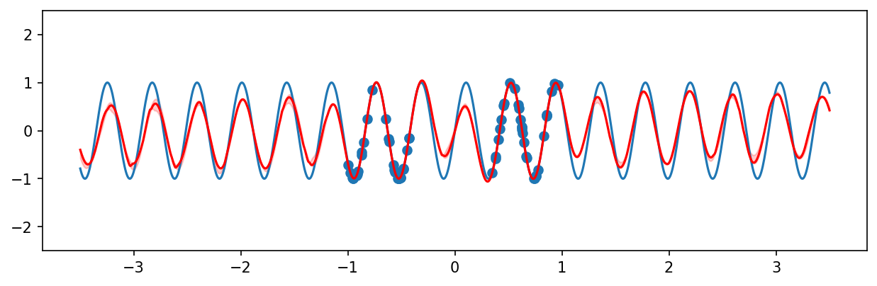
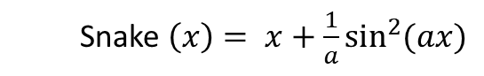

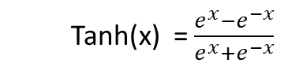
Snake Extrapolation
Tanh(x) = $\frac{e^{x}−e^{−x}}{e^{x}+e^{−x}}$
ReLU(x) = $\left\{\begin{aligned}x, if x>0 \\ 0, otherwise\end{aligned}\right.$
Snake$\left(x\right)= x+\frac{1}{a}\sin^{2}{(ax)}$

Slide 12
Competitiveness against Other Activation Functions – Periodic Data
Atmospheric temperature prediction
EUR-USD predictions
→ Snake easily outperforms other activation functions on extrapolation tasks of functions with a periodic component

Slide 13
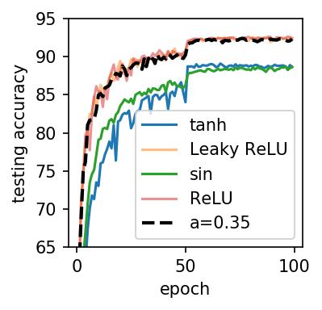
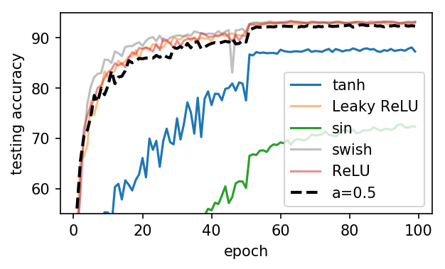
Competitiveness against Other Activation Functions – Non-Periodic Data
ResNet18 on CIFAR-10
ResNet100 on CIFAR-10
→ Snake remains competitive against the other best-performing functions, while even retaining a similar learning curve due to its monotonicity

Slide 14
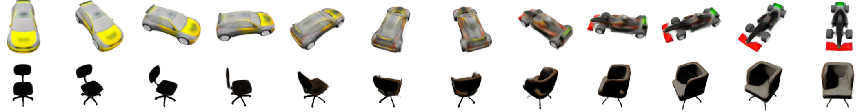
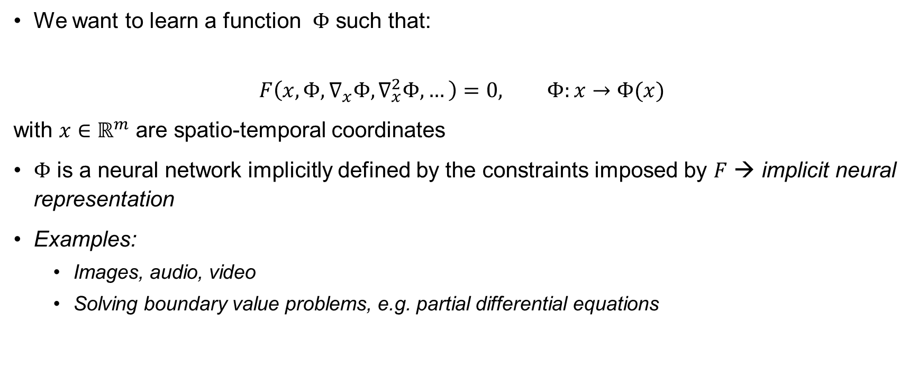
Background: Implicit Neural Representations
We want to learn a function $Φ$ such that:
$$F\left(x, Φ, ∇_{x}Φ, ∇_{x}^{2}Φ, …\right)=0, Φ:x→Φ(x)$$
with $x∈ℝ^{m}$ are spatio-temporal coordinates
$Φ$ is a neural network implicitly defined by the constraints imposed by $F$ → implicit neural representation
Examples:
Images, audio, video
Solving boundary value problems, e.g. partial differential equations

Slide 15
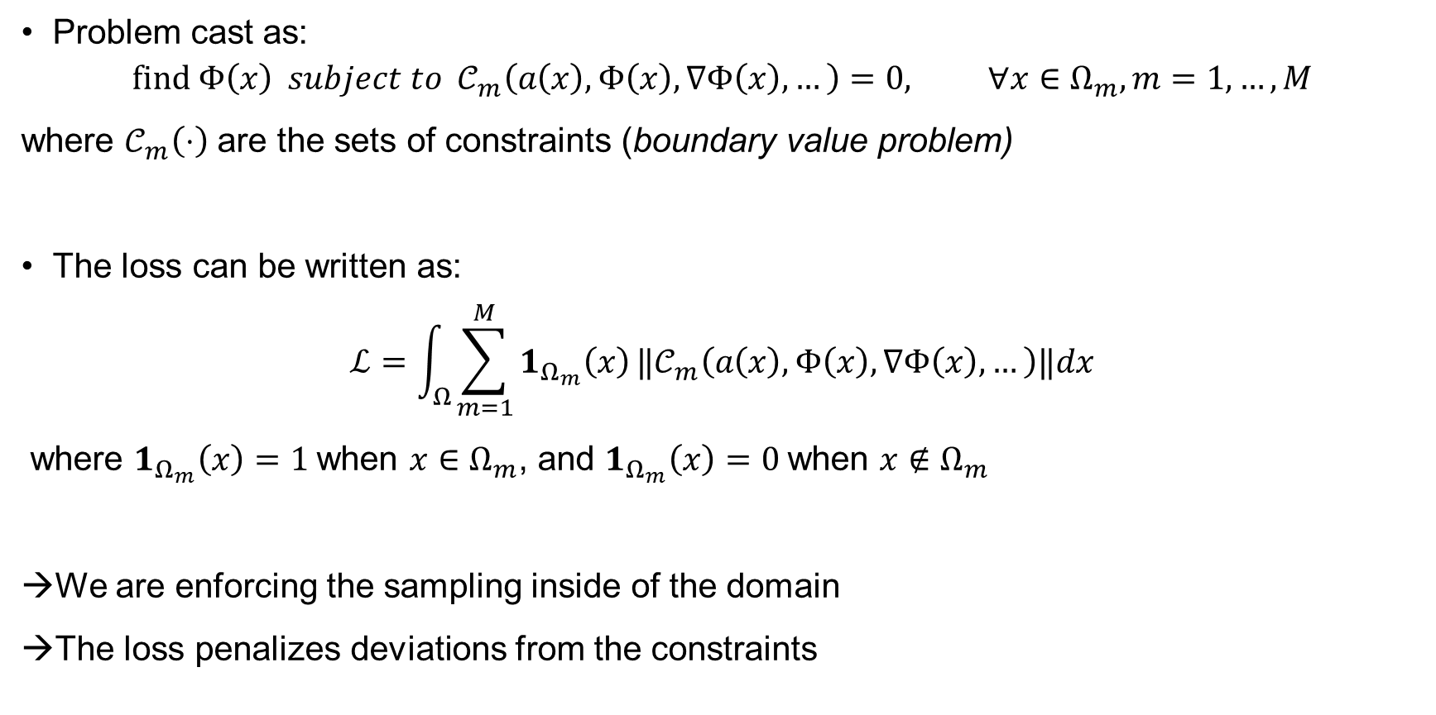
Background: Implicit Neural Representations (continued)
Problem cast as:
$$find Φ\left(x\right) subject to 𝒞_{m}\left(a\left(x\right), Φ\left(x\right), ∇Φ\left(x\right),…\right)=0, ∀x∈Ω_{m}, m=1, …,M$$
where $𝒞_{m}\left(⋅\right)$ are the sets of constraints (boundary value problem)
The loss can be written as:
$$ℒ=\int_{Ω}{\sum_{m=1}^{M}{1_{Ω_{m}}\left(x\right)}‖𝒞_{m}\left(a\left(x\right), Φ\left(x\right), ∇Φ\left(x\right),…\right)‖dx}$$
where $1_{Ω_{m}}\left(x\right)=1$when $x∈Ω_{m}$, and $1_{Ω_{m}}\left(x\right)=0$when $x∉Ω_{m}$
We are enforcing the sampling inside of the domain
The loss penalizes deviations from the constraints

Slide 16
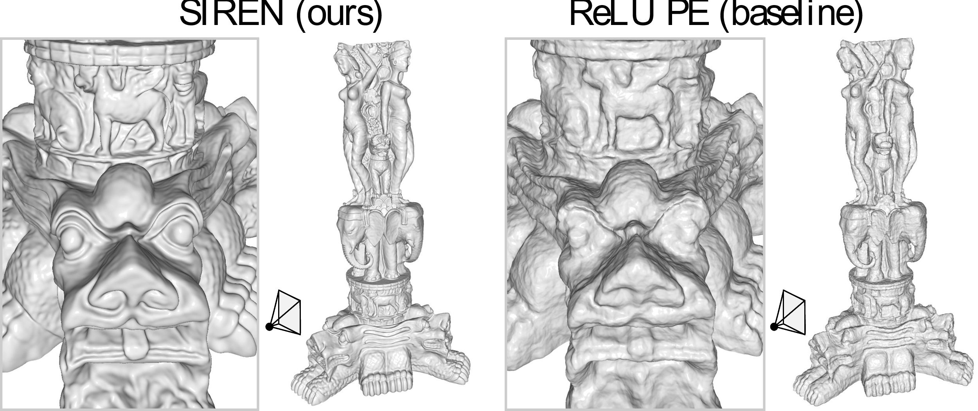
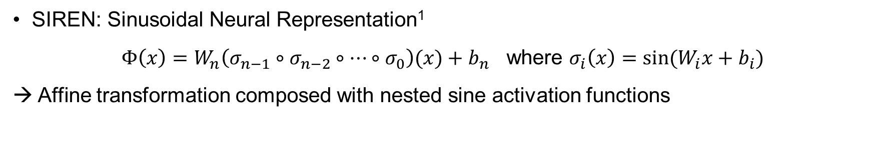
SIREN
SIREN: Sinusoidal Neural Representation¹
$Φ\left(x\right)=W_{n}\left(σ_{n−1}∘σ_{n−2}∘…∘σ_{0}\right)(x)+b_{n}$ where $σ_{i}\left(x\right)=sin⁡(W_{i}x+b_{i})$
→ Affine transformation composed with nested sine activation functions

Slide 17
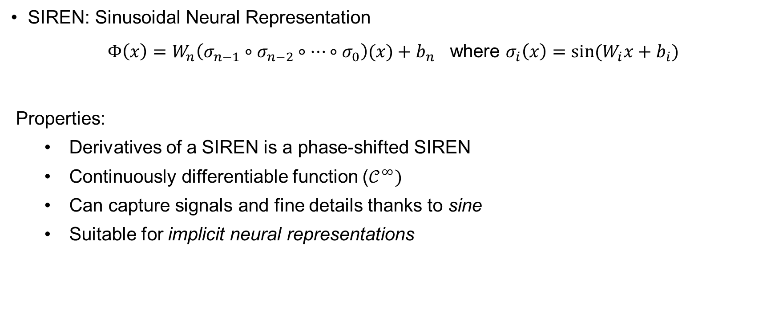
SIREN Properties
SIREN: Sinusoidal Neural Representation
$Φ\left(x\right)=W_{n}\left(σ_{n−1}∘σ_{n−2}∘…∘σ_{0}\right)(x)+b_{n}$ where $σ_{i}\left(x\right)=sin⁡(W_{i}x+b_{i})$
Properties:
Derivatives of a SIREN is a phase-shifted SIREN
Continuously differentiable function ($𝒞^{∞})$
Can capture signals and fine details thanks to sine
Suitable for implicit neural representations

Slide 18
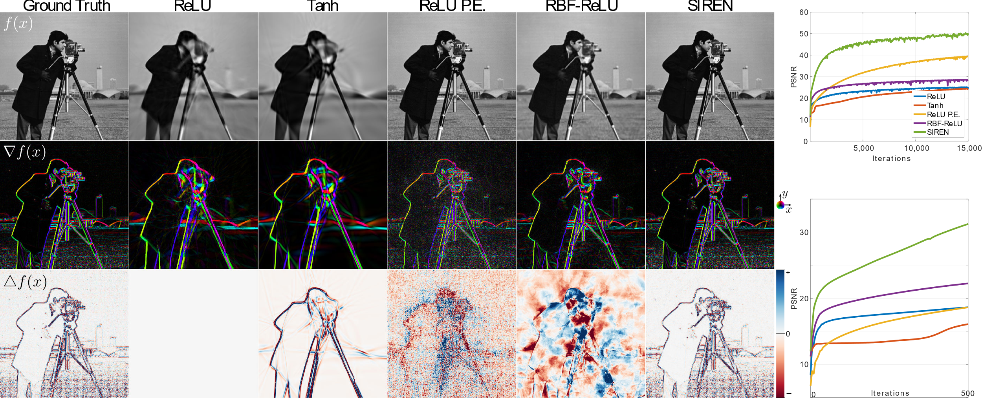
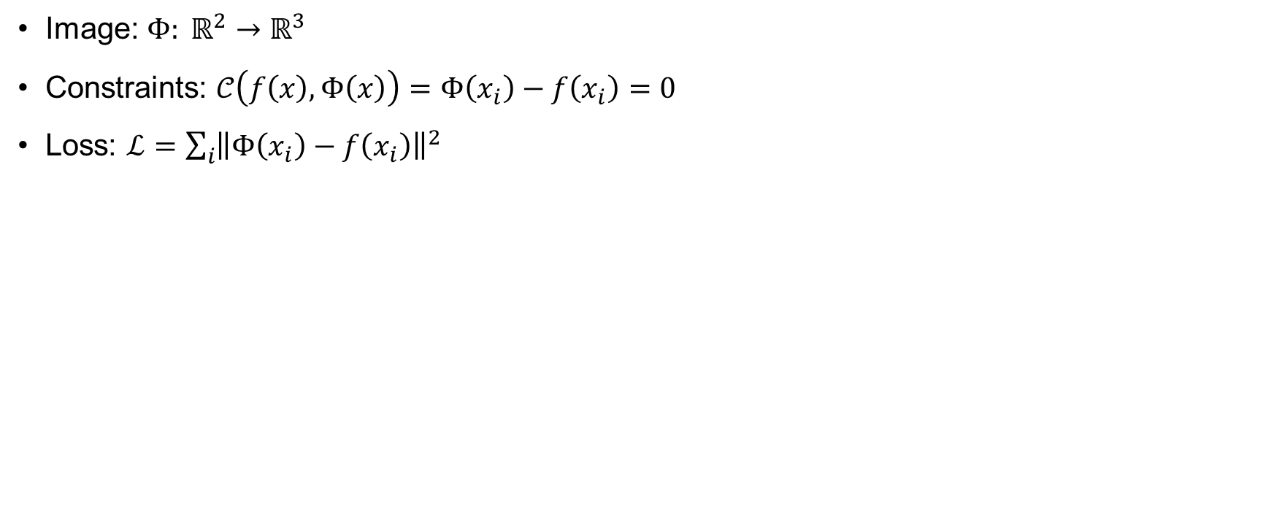
Image Learning
Image: $Φ: ℝ^{2}→ℝ^{3}$
Constraints: $𝒞\left(f\left(x\right), Φ\left(x\right)\right)=Φ\left(x_{i}\right)−f\left(x_{i}\right)=0$
Loss: $ℒ=\sum_{i}{{\left\|Φ\left(x_{i}\right)−f\left(x_{i}\right)\right\|}^{2}}$

Slide 19
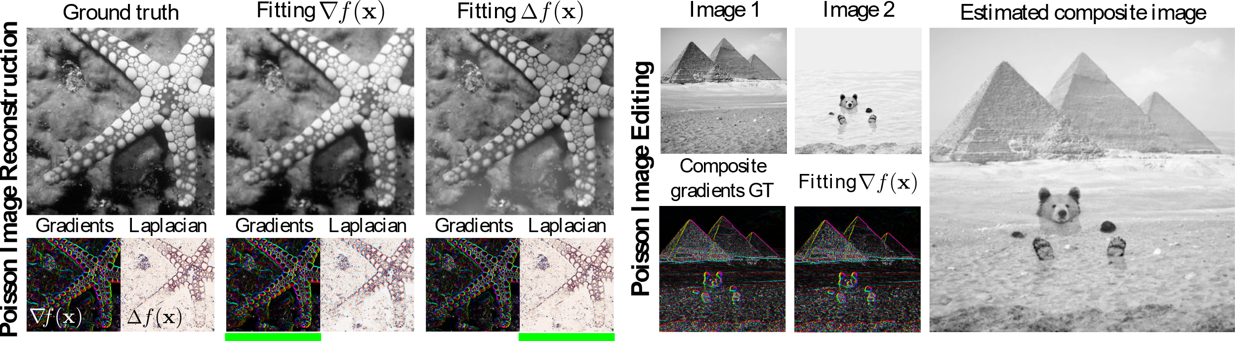
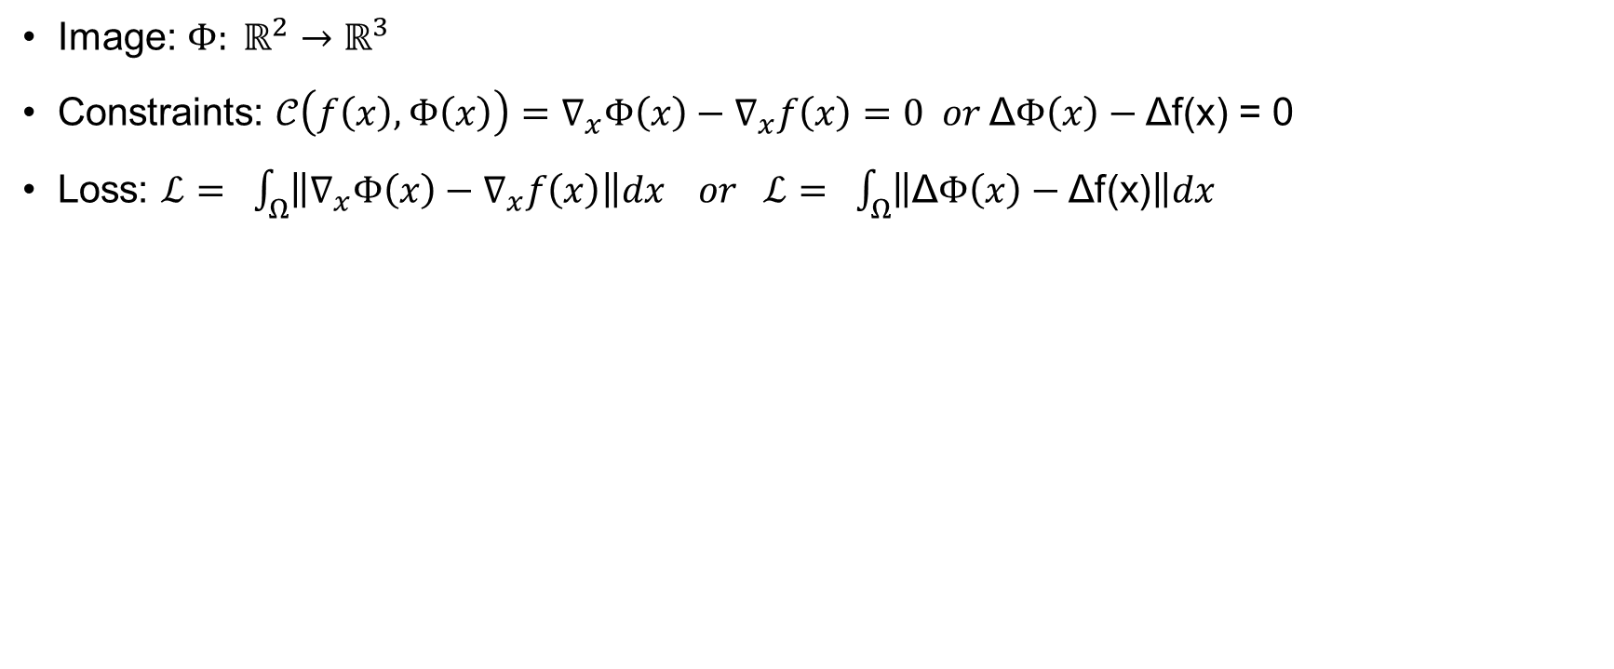
Supervising on Gradients and Laplacians
Image: $Φ: ℝ^{2}→ℝ^{3}$
Constraints: $𝒞\left(f\left(x\right), Φ\left(x\right)\right)=∇_{x}Φ\left(x\right)−∇_{x}f\left(x\right)=0 or \text{Δ}Φ\left(x\right)−\text{Δ}\text{f}\text{(}\text{x}\text{) = 0}$
Loss: $ℒ= \int_{Ω}{\left\|∇_{x}Φ\left(x\right)−∇_{x}f\left(x\right)\right\|dx } or ℒ= \int_{Ω}{\left\|\text{Δ}Φ\left(x\right)−\text{Δ}\text{f}\text{(}\text{x}\text{)}\right\|dx }$

Slide 20
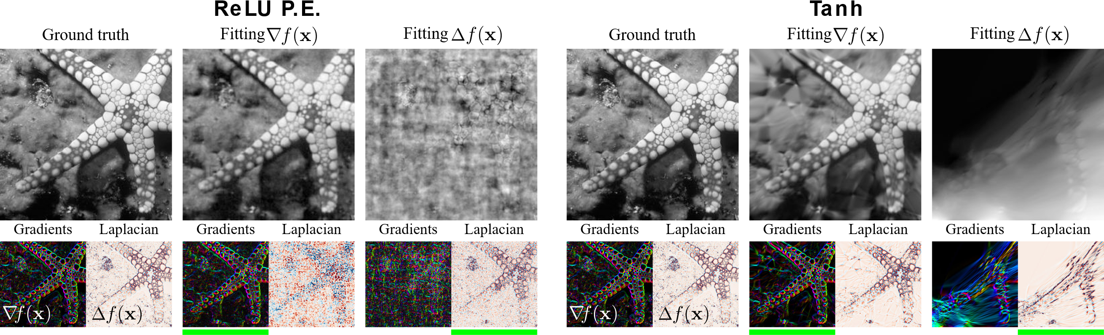
Supervising on Gradients and Laplacians (continued)
Comparing SIREN with other activation functions
ReLU P.E. (with positional encoder) cannot fit Laplacians
Same applies to Tanh
SIREN handles well all situations
SIREN

Slide 21
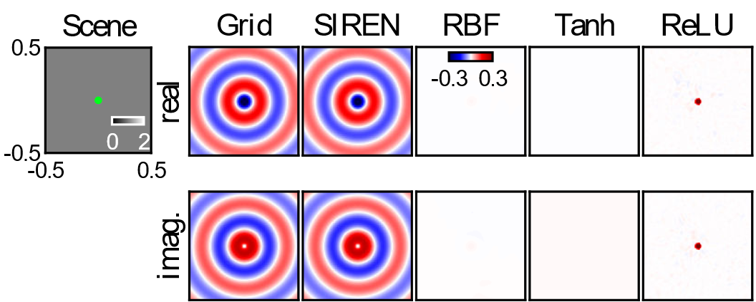
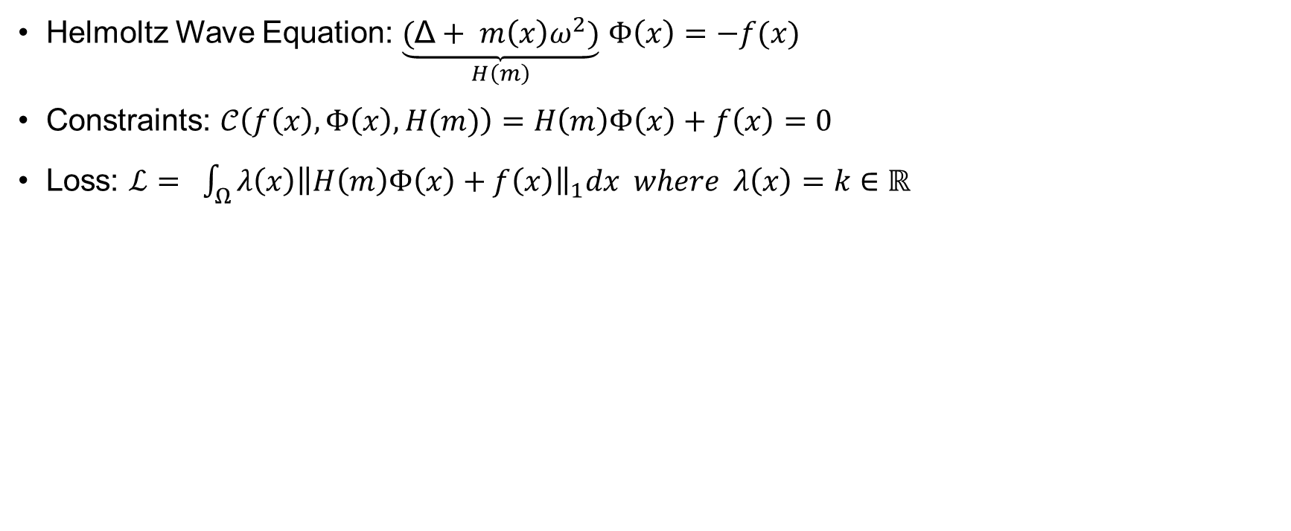
Solving Differential Equations
Helmoltz Wave Equation: $\underset{H\left(m\right)}{\underbrace{(\text{Δ}+ m\left(x\right)ω^{2})}}$ $Φ\left(x\right)=−f(x)$
Constraints: $𝒞\left(f\left(x\right), Φ\left(x\right), H(m)\right)=H\left(m\right)Φ\left(x\right)+f\left(x\right)=0$
Loss: $ℒ= \int_{Ω}{λ\left(x\right){\left\|H\left(m\right)Φ\left(x\right)+f\left(x\right)\right\|}_{1}dx where λ\left(x\right)=k∈}$ $ℝ$

Slide 22
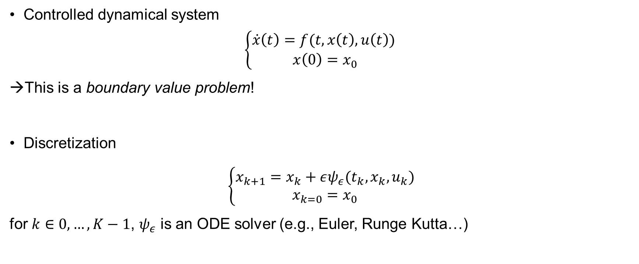
Experiments: Hypersolvers¹ for Controlled Dynamical Systems
Controlled dynamical system
$$\left\{\begin{aligned}\dot{x}\left(t\right)=f(t, x\left(t\right), u\left(t\right)) \\ x\left(0\right)=x_{0}\end{aligned}\right.$$
This is a boundary value problem!
Discretization
$\left\{\begin{aligned}x_{k+1}=x_{k}+εψ_{ε}(t_{k}, x_{k},u_{k}) \\ x_{k=0}=x_{0}\end{aligned}\right.$
for $k∈0, …, K−1$, $ψ_{ε}$ is an ODE solver (e.g., Euler, Runge Kutta…)

Slide 23
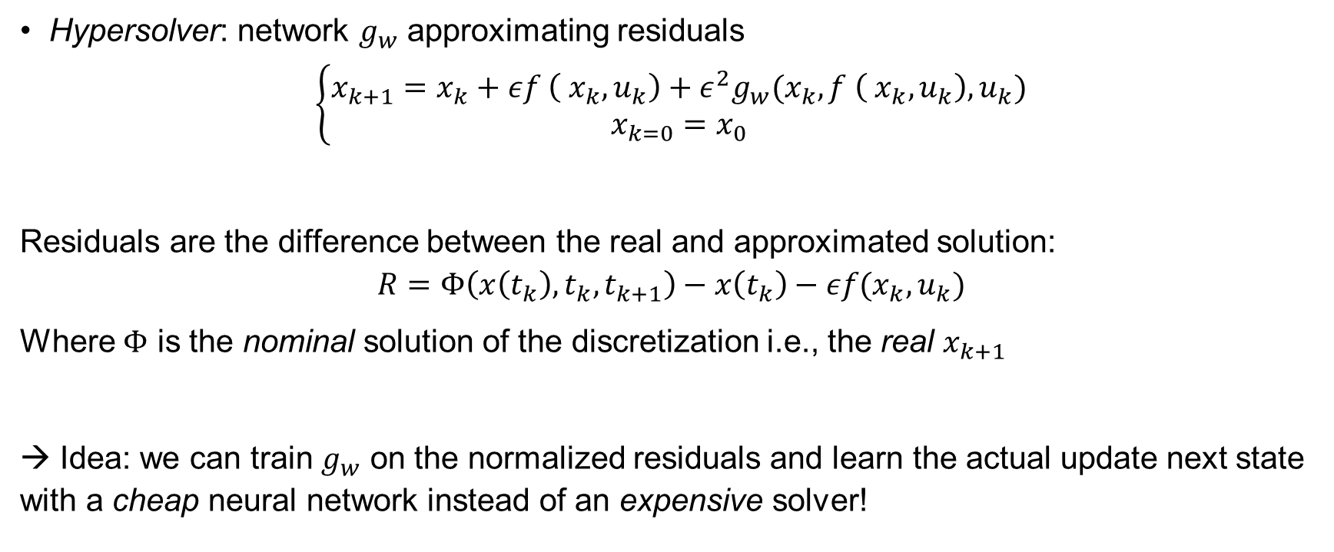
Experiments: Hypersolvers¹ for Controlled Dynamical Systems (continued)
Hypersolver: network $g_{w}$ approximating residuals
$$\left\{\begin{aligned}x_{k+1}=x_{k}+εf \left({ x}_{k},u_{k}\right)+ε^{2}g_{w}(x_{k},f \left({ x}_{k},u_{k}\right), u_{k}) \\ x_{k=0}=x_{0}\end{aligned}\right.$$
Residuals are the difference between the real and approximated solution:
$$R=Φ\left(x\left(t_{k}\right),t_{k},t_{k+1}\right)−x\left(t_{k}\right)−εf(x_{k},u_{k})$$
Where $Φ$ is the nominal solution of the discretization i.e., the real $x_{k+1}$
→ Idea: we can train $g_{w}$ on the normalized residuals and learn the actual update next state with a cheap neural network instead of an expensive solver!

Slide 24
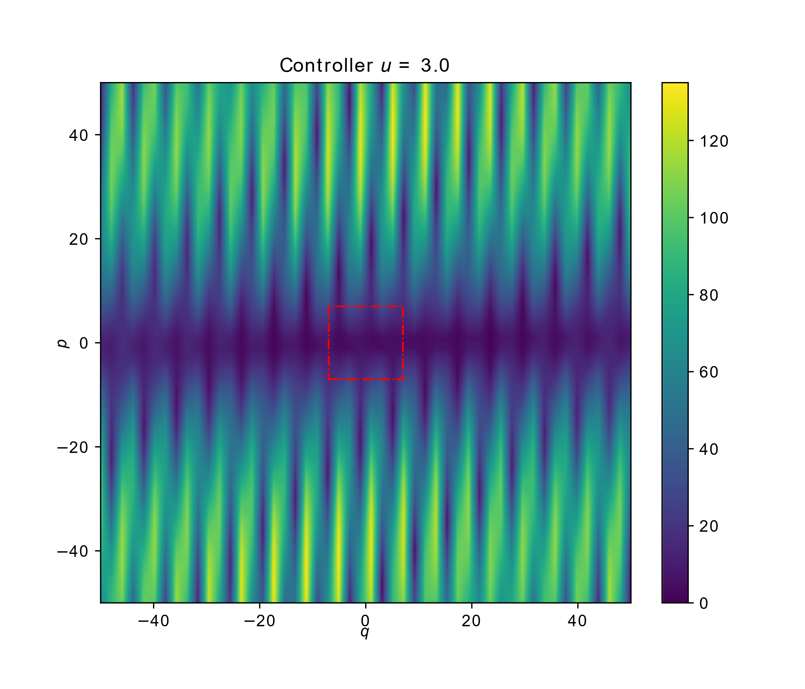
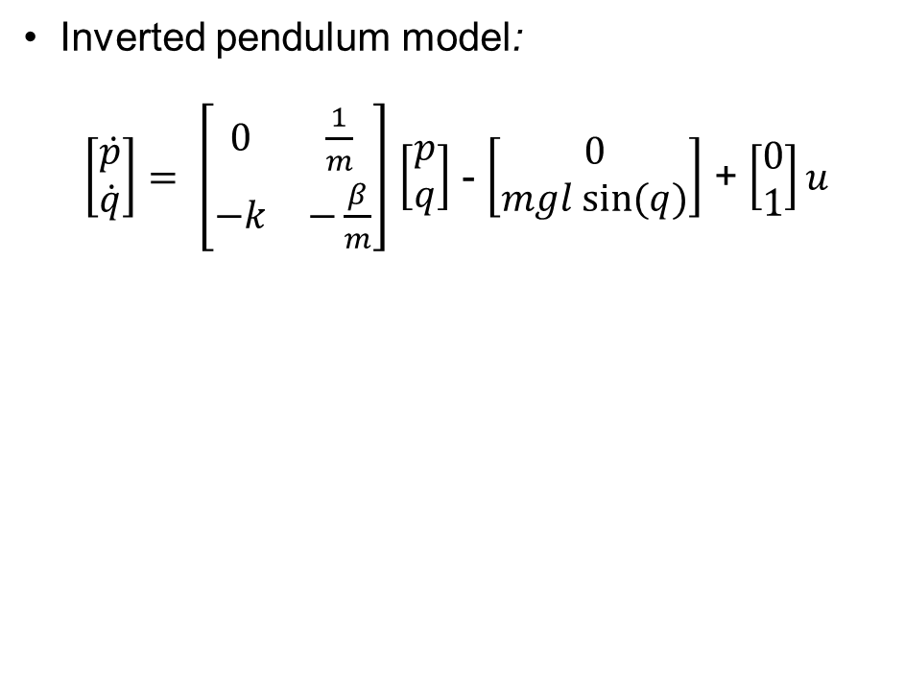
Residuals on the Inverted Pendulum
Inverted pendulum model:
$\left[\begin{aligned}\dot{p} \\ \dot{q}\end{aligned}\right]= \left[\begin{matrix}0 & \frac{1}{m} \\ −k & −\frac{β}{m}\end{matrix}\right]$ $\left[\begin{aligned}p \\ q\end{aligned}\right]$ - $\left[\begin{aligned}0 \\ mgl sin⁡(q)\end{aligned}\right]$ + $\left[\begin{aligned}0 \\ 1\end{aligned}\right]u$
Residual landscape at training start ($g_{w}(⋅)=0$)

Slide 25
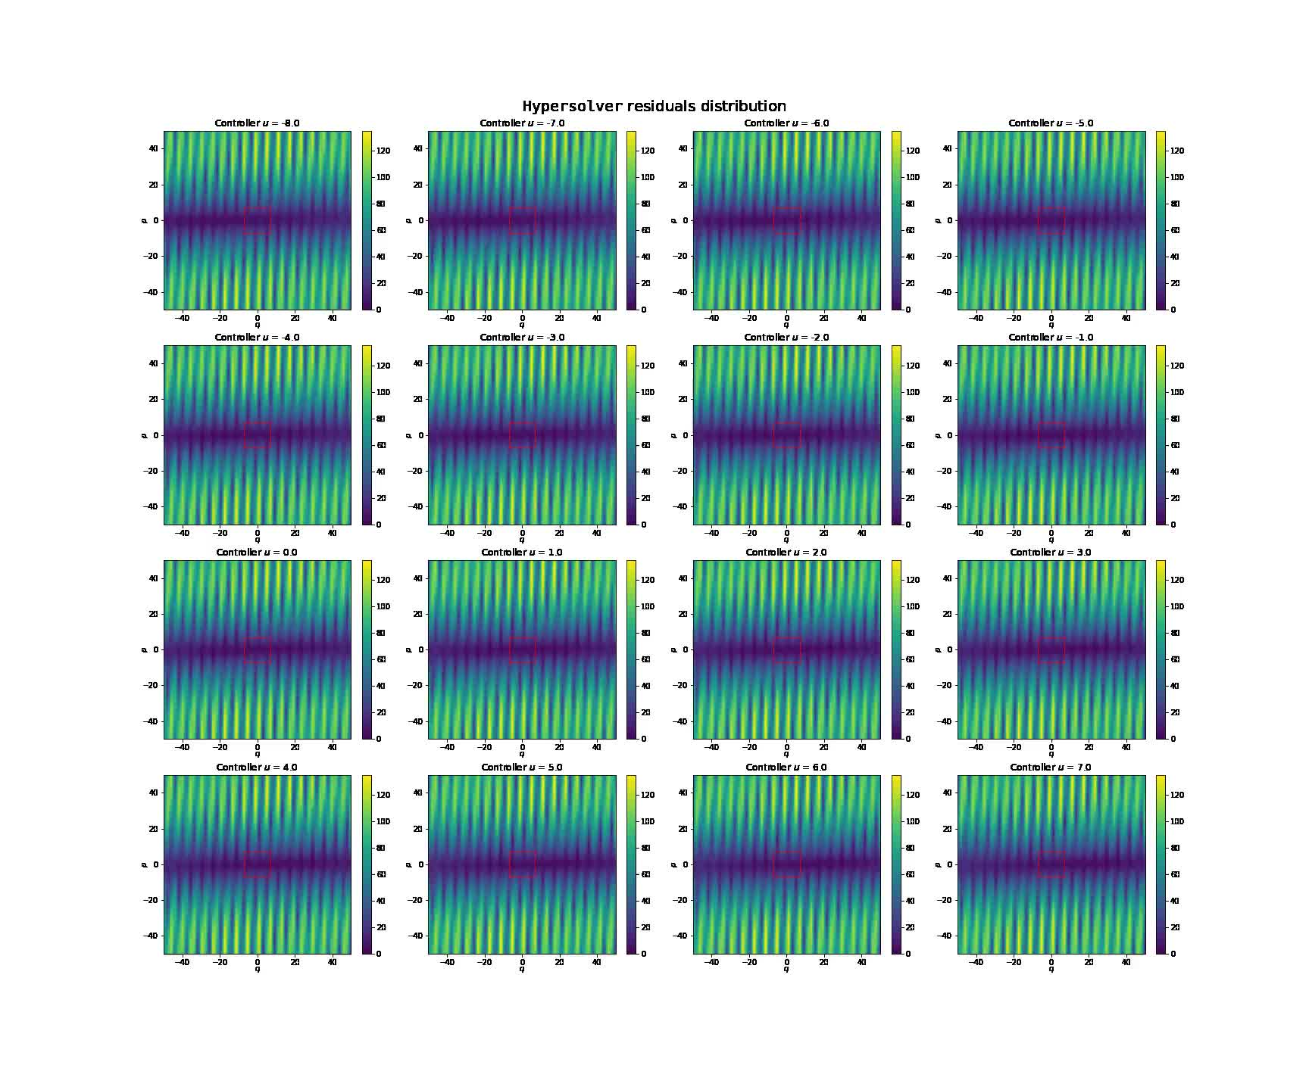
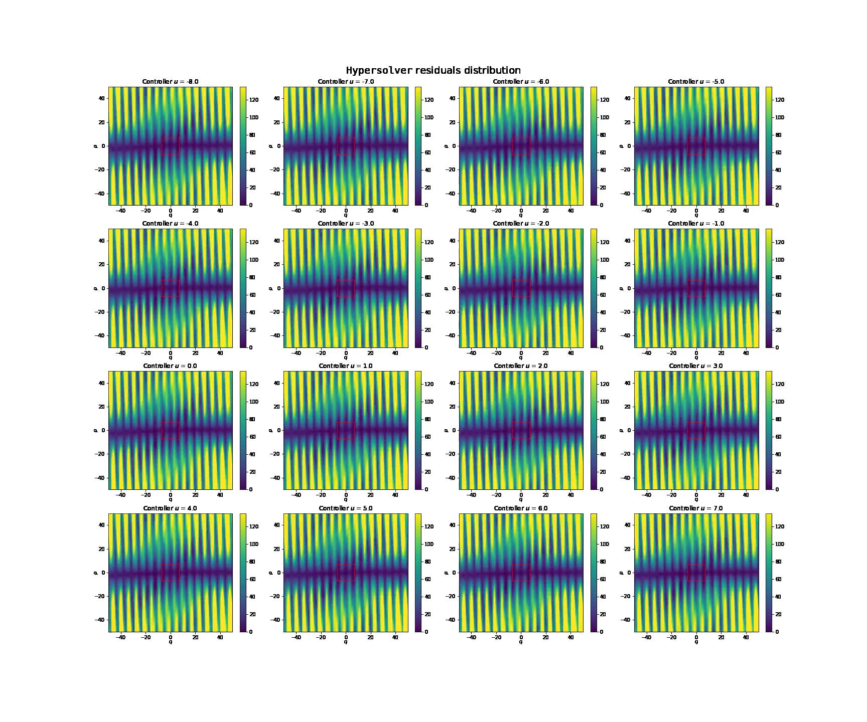
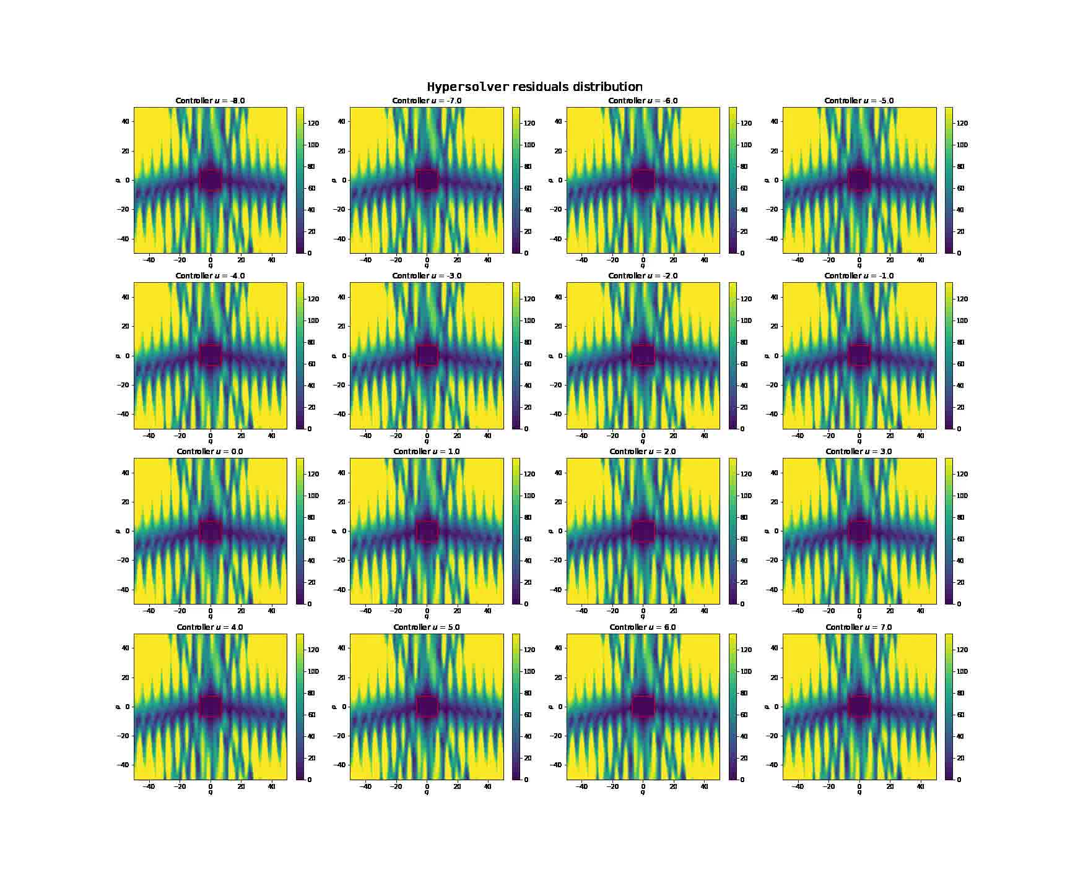
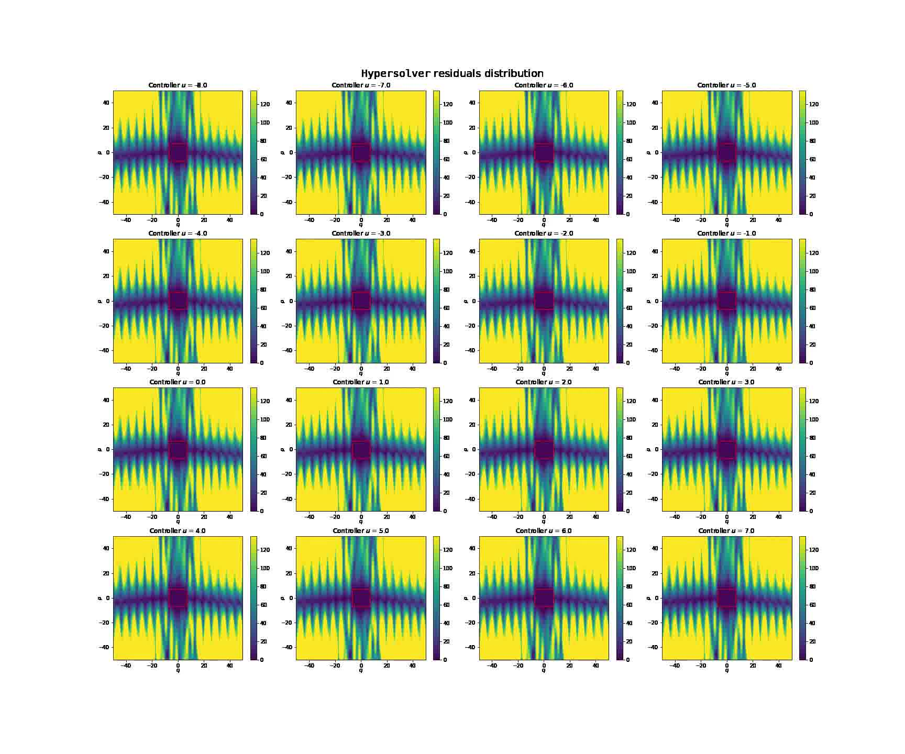
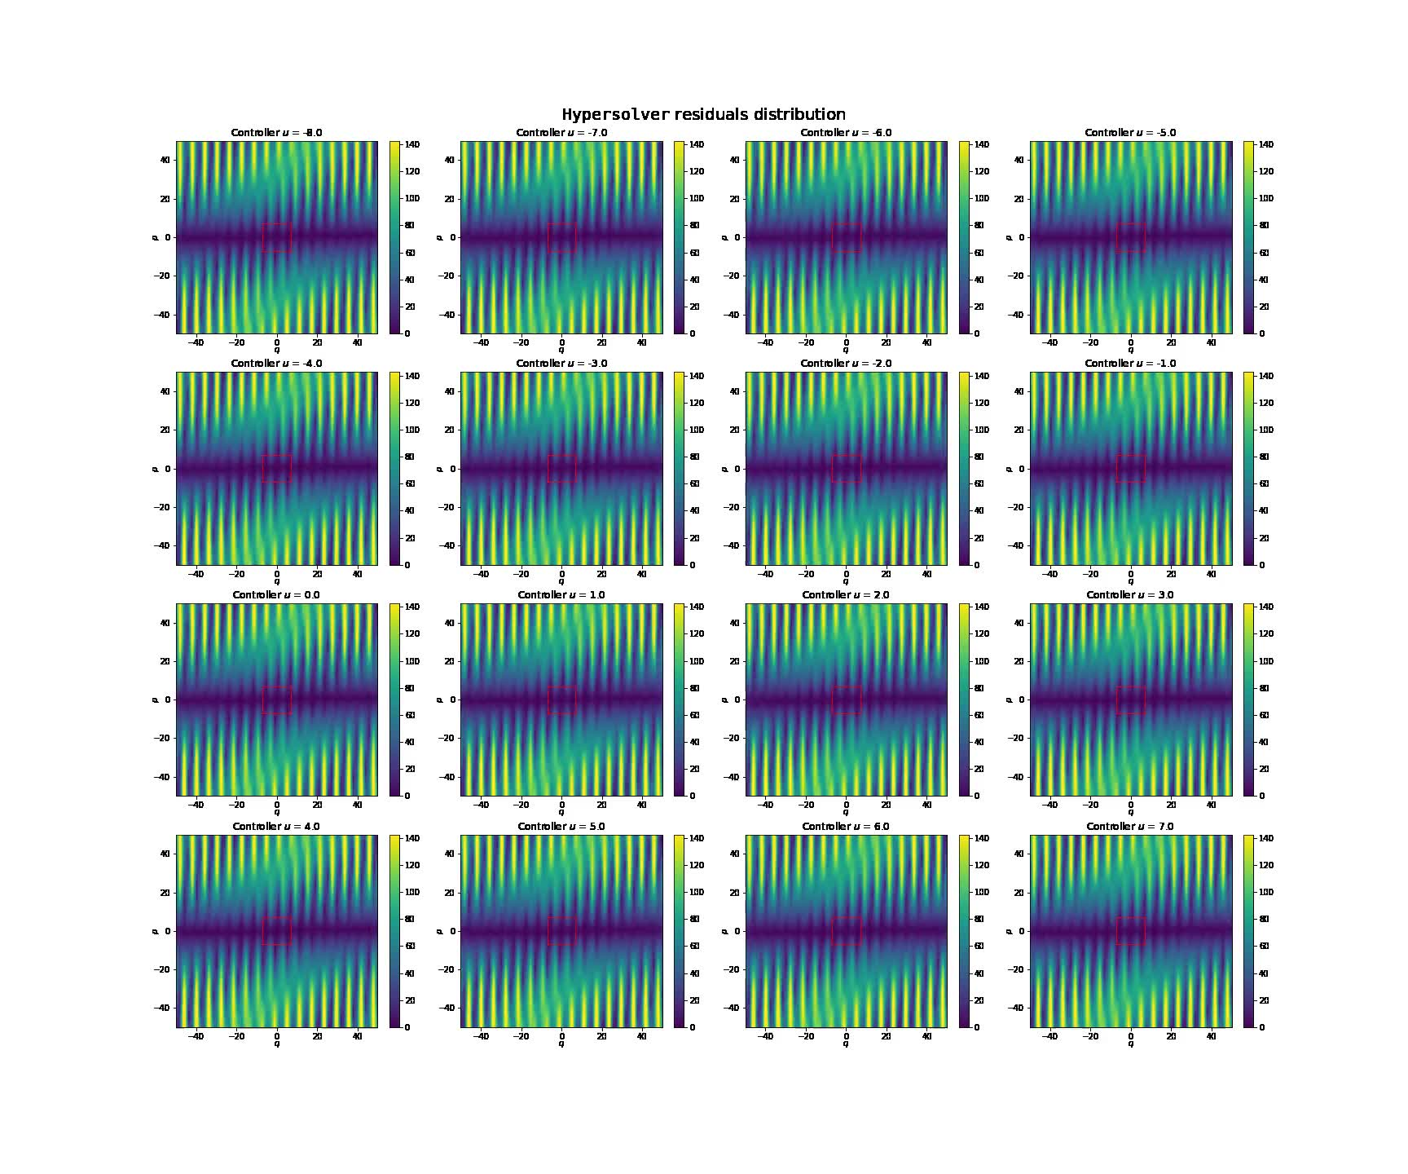
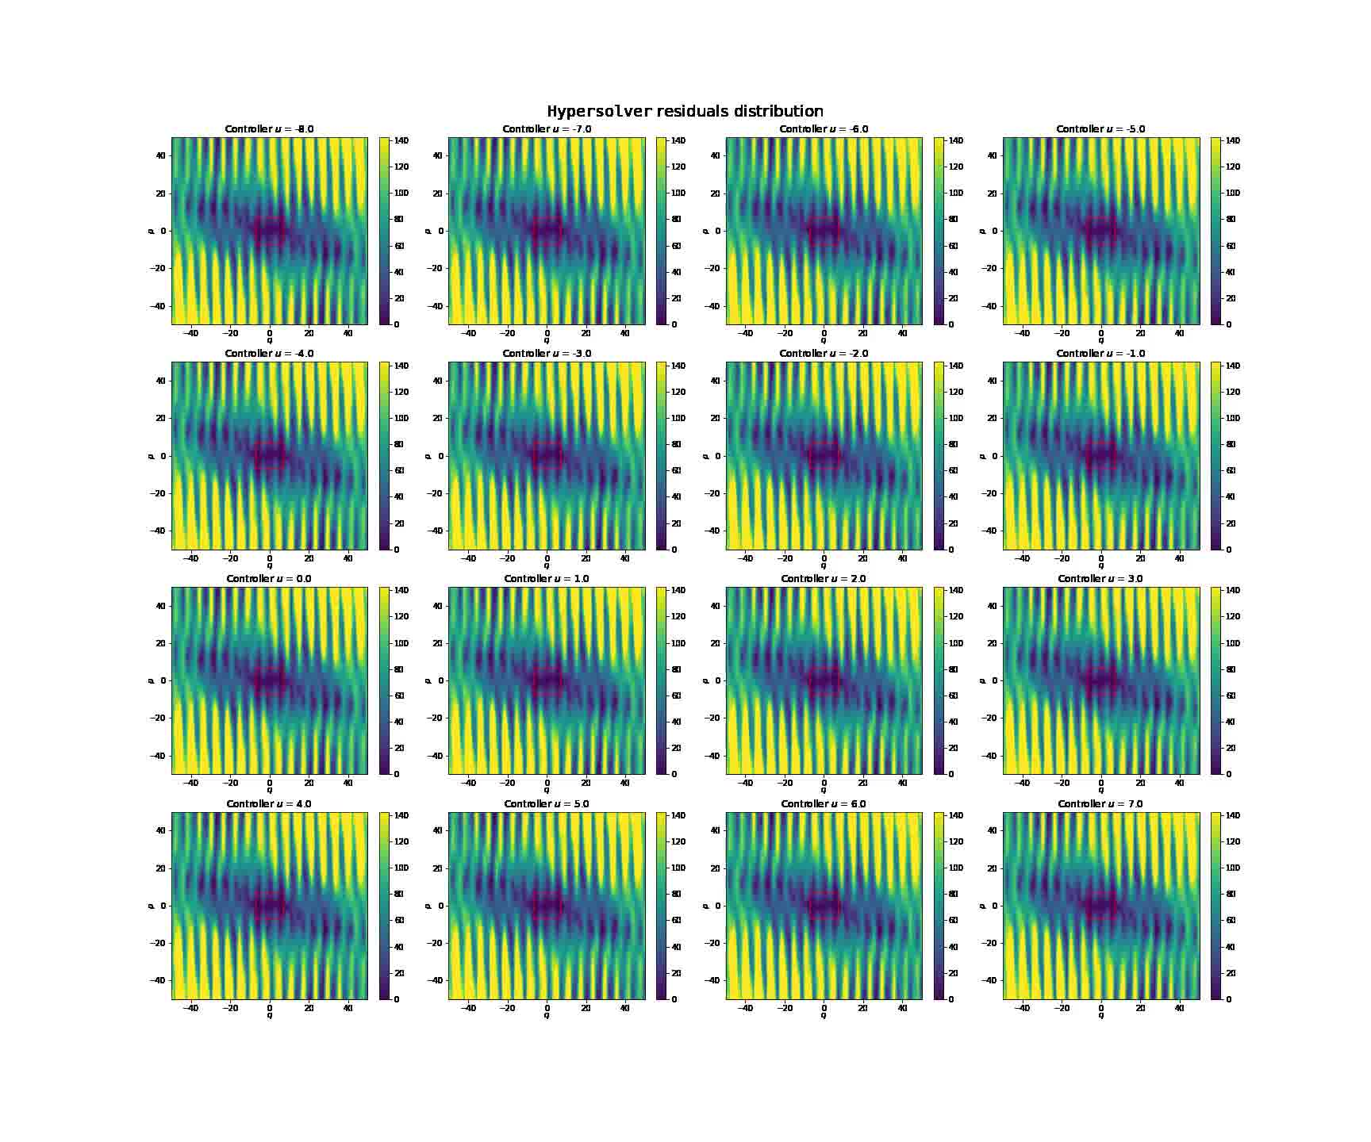
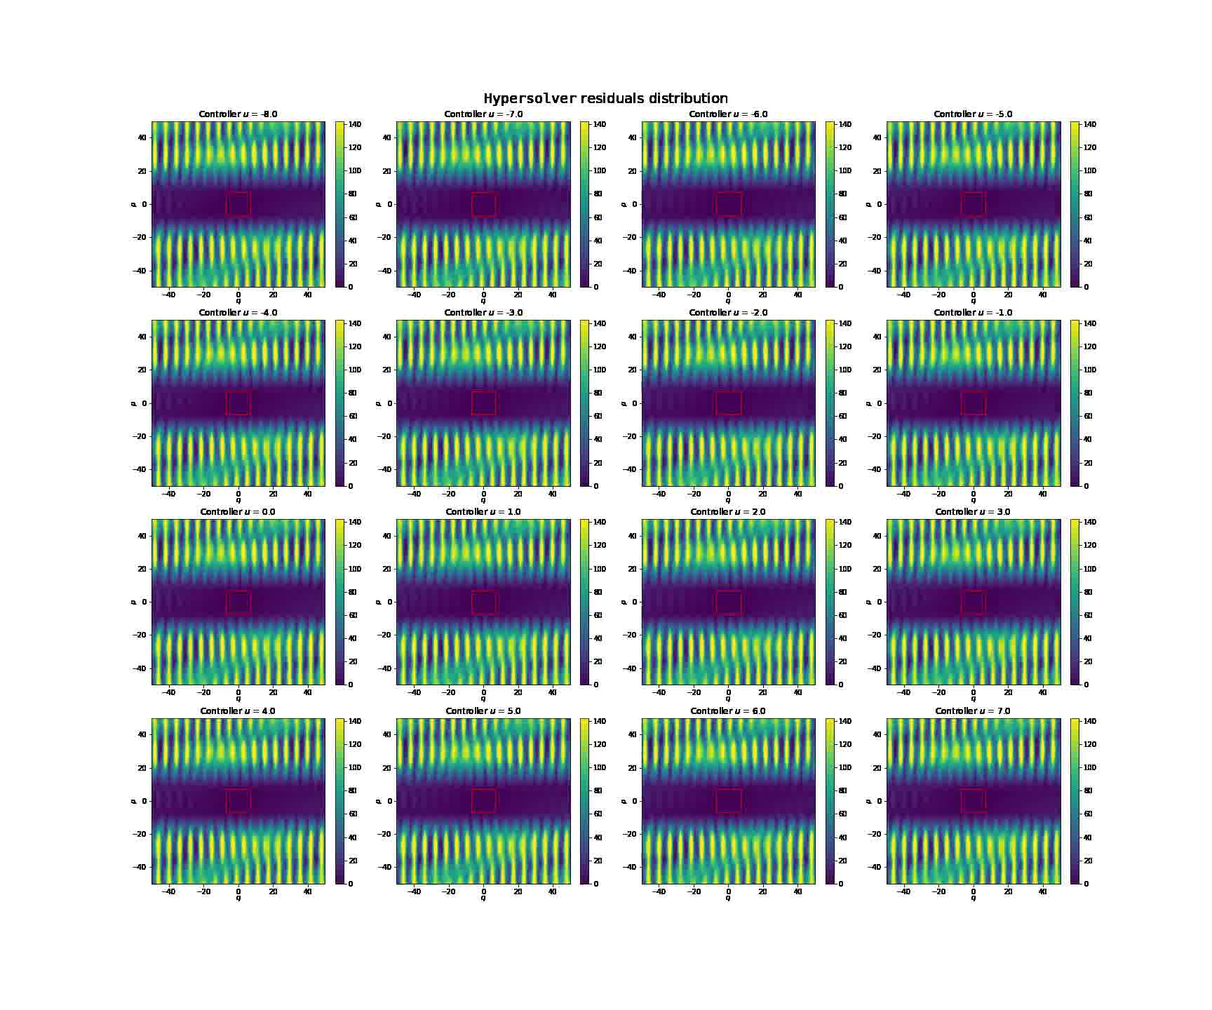
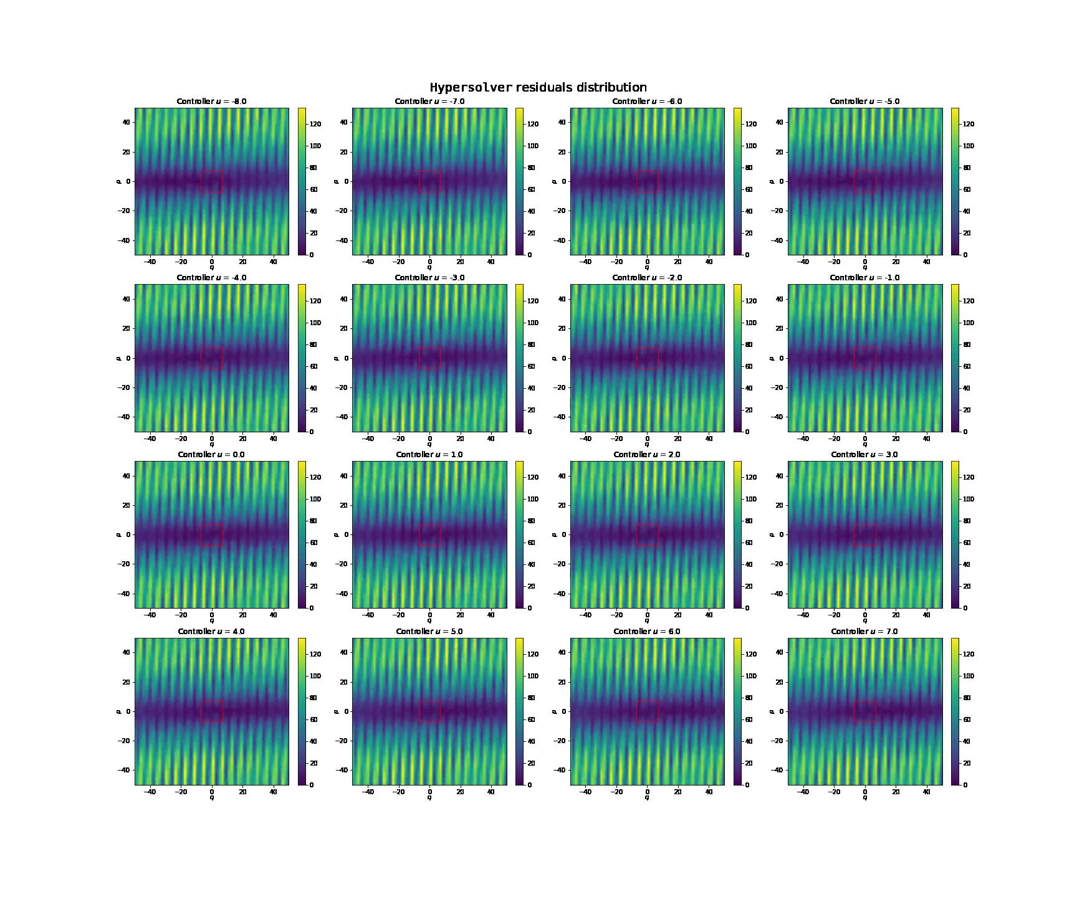
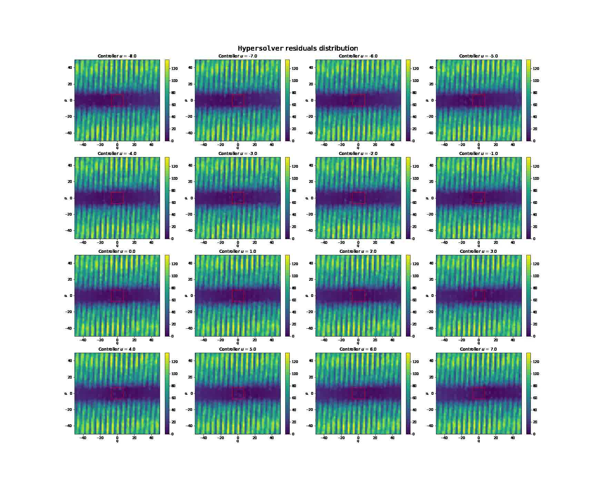
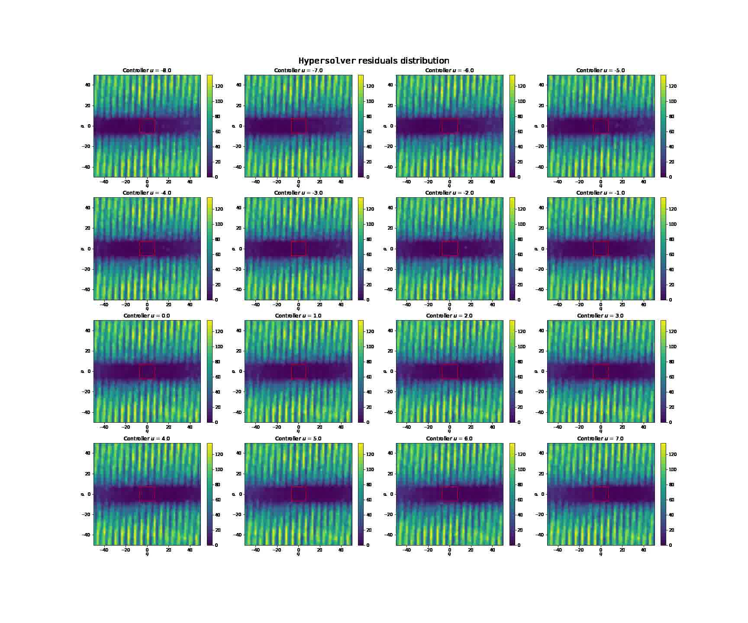
Residual Shape Comparison with Activation Functions
Softplus
Snake
SIREN
Training Epochs

Slide 26
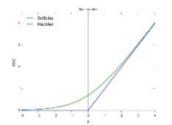
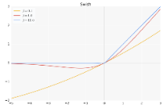
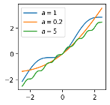


Revised Overview of Activation Functions
Function | Formula | Graph | Range | Saturation | Computation | $$𝒞^{1}$$ | Extrapolation
Sigmoid | $$\frac{1}{1+e^{−x}}$$ |  | $$[0, 1]$$ | Negative and positive values | Intensive | ✓ | ✘
Tanh | $$\frac{e^{x}−e^{−x}}{e^{x}+e^{−x}}$$ |  | $$[−1, 1]$$ | Negative and positive values | Intensive | ✓ | ✘
ReLU | $$\left\{\begin{aligned}x, if x>0 \\ 0, otherwise\end{aligned}\right.$$ |  | $$[0, +∞]$$ | Negative values (dying ReLU) | Easy | ✘ | ✘
Leaky ReLU | $$\left\{\begin{aligned}x, if x>0 \\ ax, otherwise\end{aligned}\right.$$ |  | $$[−∞, +∞]$$ | None | Easy | ✘ | ✘
Softplus | $$ln⁡(1+e^{x})$$ |  | $$\left[−∞, +∞\right]$$ | Large negative values | Intensive | ✓ | ✘
Swish | $$\frac{x}{1+e^{−βx}}$$ |  | $$[−∞, +∞]$$ | Depending on $β$ | Intensive | ✓ | ✘
Snake | $$x+\frac{1}{a}\sin^{2}{(ax)}$$ |  | $$[−∞, +∞]$$ | None | Intensive† | ✓ | ✓
SIREN | $$\sin\left(W_{i}x+b_{i}\right)$$ $$∀i∈[0,n−1]$$ |  | $$[−∞, +∞]$$ | None | Intensive† | ✓ | ✓

Slide 27
Thanks for your attention!

